Slide 1
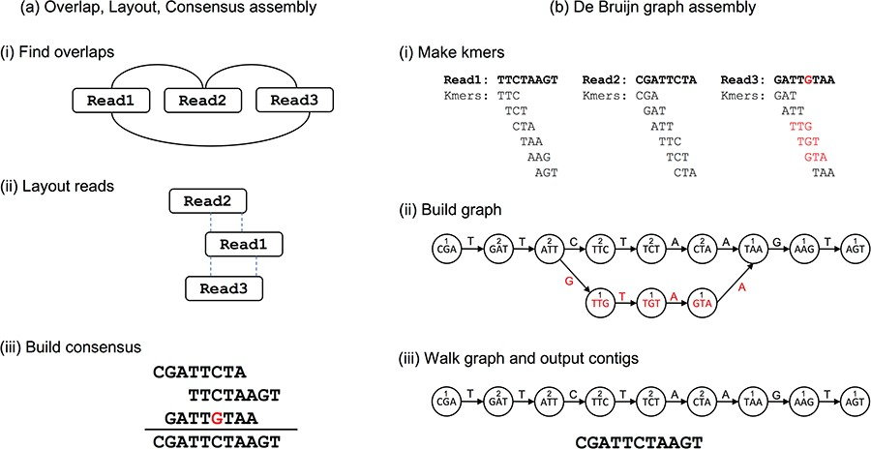

Figure 1 Two different approaches to genome assembly: (a) in Overlap, Layout, Consensus assembly, (i) overlaps are ...
Notes:
Figure 1 Two different approaches to genome assembly: (a) in Overlap, Layout, Consensus assembly, (i) overlaps are found between reads and an overlap graph constructed (edges indicate overlapping reads). (ii) Reads are laid out into contigs based on the overlaps (dashed lines indicate overlapping portions). (iii) The most likely sequence is chosen to construct consensus sequence. (b) In dBg assembly, (i) reads are decomposed into kmers by sliding a window of size k across the reads. (ii) The kmers become vertices in the dBg, with edges connecting overlapping kmers. Polymorphisms (red) form branches in the graph. A count is kept of how many times a kmer is seen, shown here as numbers above kmers. (iii) Contigs are built by walking the graph from edge nodes. A variety of heuristics handle branches in the graphs—for example, low coverage paths, as shown here, may be ignored.
Unless provided in the caption above, the following copyright applies to the content of this slide: © The Author(s) 2019. Published by Oxford University Press.This is an Open Access article distributed under the terms of the Creative Commons Attribution License (http://creativecommons.org/licenses/by/4.0/), which permits unrestricted reuse, distribution, and reproduction in any medium, provided the original work is properly cited.

